Slide 1
Version control with Git
10.27.17

Slide 2
Our Project
Wolfman and Dracula have been hired by Universal Missions (a space services spinoff from Euphoric State University) to investigate if it is possible to send their next planetary lander to Mars.
How to work on it together and simultaneously?
How to make sure nothing get lost?
Version Control using Git!!
Nothing is ever lost. You can take ‘snapshots’ of your work, called commits that act as little checkpoints.
Changes are annotated by the author of the commit: so you know who does what
Unwanted changes can be reverted!

Slide 3
Benefits beyond monsters
Researchers can use Git and version control to track project progress, manuscript edits, etc.
It is the lab notebook of the digital world. It allows you keep track and revisit what was done, even years down the line!
Works best with text, but can be used to store anything that changes with time and would benefit by tracking these changes

Slide 4
Prerequisites
Git should be installed
A little experience with Unix shell
A text editor – nano, vim, notepad++, sublime

Slide 5
Automated Version Control
Questions
What is version control and why should I use it?
Objectives
Understand the benefits of an automated version control system
Understand the basics of how Git works

Slide 6
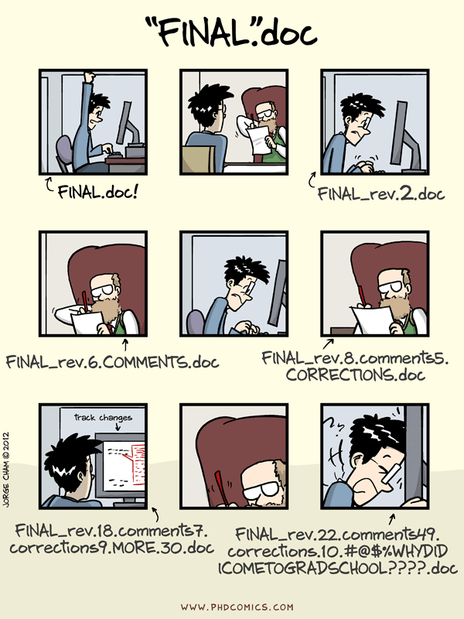
“Piled Higher and Deeper” by Jorge Cham, http://www.phdcomics.com

Slide 7
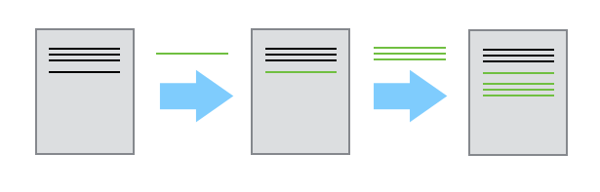
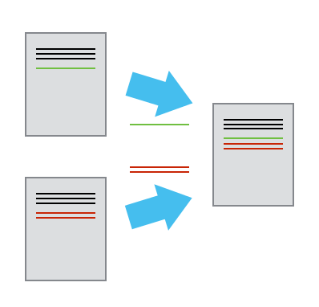
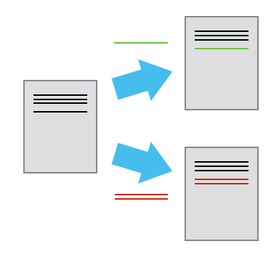
-Changes are tracked as commits: all with useful metadata: a message, time, changes made, author, etc.
-This complete history of commits for a particular project is called a repository
-Repositories can be kept in sync across different computers facilitating collaboration among different people.

Slide 8
Automated Version Control
Exercises
Imagine you drafted an excellent paragraph for a paper you are writing, but later ruin it. How would you retrieve the excellent version of your conclusion? Is it even possible?
Imagine you have 5 co-authors. How would you manage the changes and comments they make to your paper? If you use LibreOffice Writer or Microsoft Word, what happens if you accept changes made using the Track Changes option? Do you have a history of those changes?

Slide 9
Setting Up Git
Questions
How do I get set up to use Git?
Objectives
Configure git the first time it is used on a computer.
Understand the meaning of the --global configuration flag.

Slide 10
Some common things to configure
our name and email address <- so people know who you are!
to colorize our output
what our preferred text editor is <- nano, vim, etc.
and that we want to use these settings globally (i.e. for every project)
These are general written:
git verb

Slide 11
Setting an editor
Atom | $ git config --global core.editor "atom --wait"
nano | $ git config --global core.editor "nano -w"
BBEdit (Mac, with command line tools) | $ git config --global core.editor "edit -w"
Sublime Text (Mac) | $ git config --global core.editor "subl -n -w"
Sublime Text (Win, 32-bit install) | $ git config --global core.editor "'c:/program files (x86)/sublime text 3/sublime_text.exe' -w"
Sublime Text (Win, 64-bit install) | $ git config --global core.editor "'c:/program files/sublime text 3/sublime_text.exe' -w"
Notepad++ (Win, 32-bit install) | $ git config --global core.editor "'c:/program files (x86)/Notepad++/notepad++.exe' -multiInst -notabbar -nosession -noPlugin"
Notepad++ (Win, 64-bit install) | $ git config --global core.editor "'c:/program files/Notepad++/notepad++.exe' -multiInst -notabbar -nosession -noPlugin"
Kate (Linux) | $ git config --global core.editor "kate"
Gedit (Linux) | $ git config --global core.editor "gedit --wait --new-window"
Scratch (Linux) | $ git config --global core.editor "scratch-text-editor"
emacs | $ git config --global core.editor "emacs"
vim | $ git config --global core.editor "vim"

Slide 12
Creating a Repository
Questions
Where does Git store information?
Objectives
Create a local Git repository.

Slide 13
Tracking Changes
Questions
How do I record changes in Git?
How do I check the status of my version control repository?
How do I record notes about what changes I made and why?
Objectives
Go through the modify-add-commit cycle for one or more files.
Explain where information is stored at each stage of Git commit workflow.

Slide 14
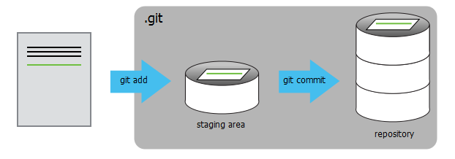

Slide 15
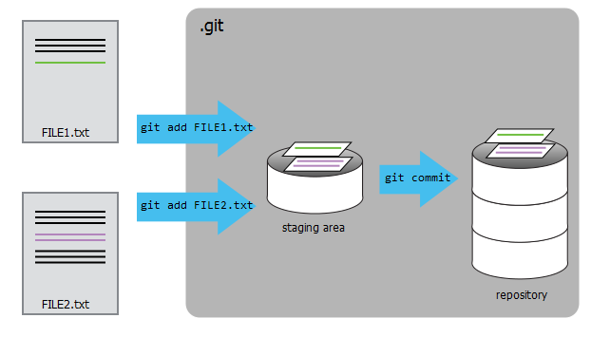

Slide 16
Tracking Changes
Exercises
Which of the following commit messages would be most appropriate for the last commit made to mars.txt?
“Changes”
“Added line ‘But the Mummy will appreciate the lack of humidity’ to mars.txt”
“Discuss effects of Mars’ climate on the Mummy”
Which command(s) below would save the changes of myfile.txt to my local Git repository?
$ git commit -m "my recent changes"
$ git init myfile.txt $ git commit -m "my recent changes"
$ git add myfile.txt $ git commit -m "my recent changes"
$ git commit -m myfile.txt "my recent changes“
The staging area can hold changes from any number of files that you want to commit as a single snapshot.
Add some text to mars.txt noting your decision to consider Venus as a base
Create a new file venus.txt with your initial thoughts about Venus as a base for you and your friends
Add changes from both files to the staging area, and commit those changes.

Slide 17
Exploring History
Questions
How can I identify old versions of files?
How do I review my changes?
How can I recover old versions of files?
Objectives
Explain what the HEAD of a repository is and how to use it.
Identify and use Git commit numbers.
Compare various versions of tracked files.
Restore old versions of files.

Slide 18
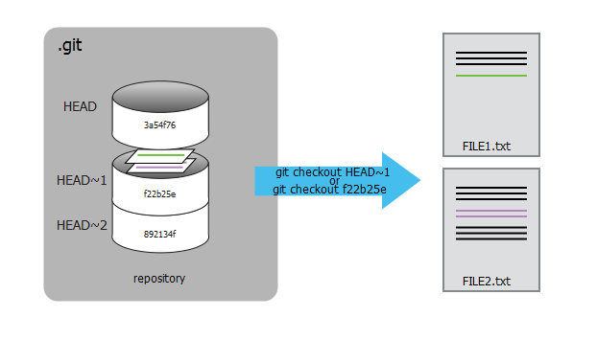

Slide 19
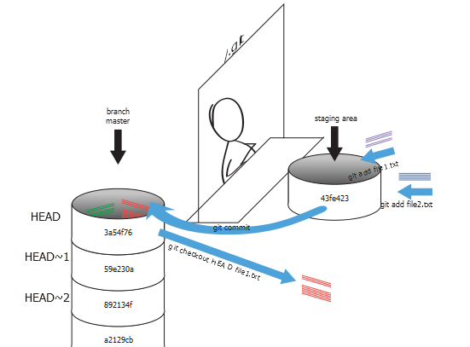

Slide 20
Exploring History
Exercises
What is the output of cat venus.txt at the end of this set of commands?
$ cd planets
$ nano venus.txt #input the following text: Venus is beautiful and full of love
$ git add venus.txt
$ nano venus.txt #add the following text: Venus is too hot to be suitable as a base
$ git commit -m "Comment on Venus as an unsuitable base"
$ git checkout HEAD venus.txt
$ cat venus.txt #this will print the contents of venus.txt to the screen
“Venus is too hot to be suitable as a base”
“Venus is beautiful and full of love”
“Venus is beautiful and full of love
Venus is too hot to be suitable as a base”
4. Error because you have changed venus.txt without committing the changes
Which command(s) below would save the changes of myfile.txt to my local Git repository?
$ cd planets
$ nano venus.txt #input the following text: Venus is beautiful and full of love
$ git add venus.txt
$ nano venus.txt #add the following text: Venus is too hot to be suitable as a base
$ git commit -m "comments on Venus as an unsuitable base"
$ git checkout HEAD venus.txt
$ cat venus.txt #this will print the contents of venus.txt to the screen
git checkout can be used to restore a previous commit when unstaged changes have been made, but will it also work for changes that have been staged but not committed? Make a change to mars.txt, add that change, and use git checkout to see if you can remove your change.

Slide 21
Ignoring Things
Questions
How can I tell Git to ignore files I don’t want to track?
Objectives
Configure Git to ignore specific files.
Explain why ignoring files can be useful.

Slide 22
Ignoring Things
Exercises
Given a directory structure that looks like:
results/data/position/gps/a.data
results/data/position/gps/b.data
results/data/position/gps/c.data
results/data/position/gps/info.txt
results/plots
-What’s the shortest .gitignore rule you could write to ignore all .data files in result/data/position/gps? Do not ignore the info.txt.

Slide 23
Remotes in GitHub
Questions
How do I share my changes with others on the web?
Objectives
Explain what remote repositories are and why they are useful.
Push to or pull from a remote repository.

Slide 24
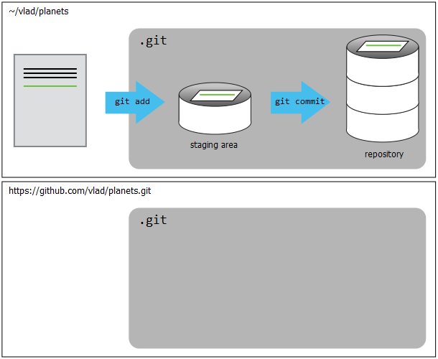

Slide 25
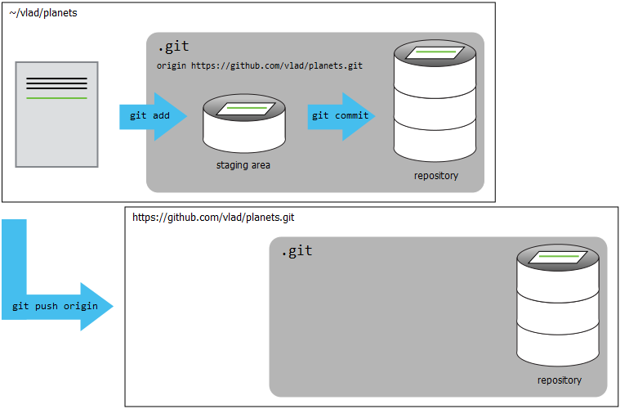

Slide 26
Remotes in GitHub
Exercises
In this lesson, we introduced the “git push” command. How is “git push” different from “git commit”?
Create a remote repository on GitHub. Push the contents of your local repository to the remote. Make changes to your local repository and push these changes. Go to the repo you just created on Github and check the timestamps of the files. How does GitHub record times, and why?

Slide 27
Collaborating
Questions
How can I use version control to collaborate with other people?
Objectives
Clone a remote repository.
Collaborate pushing to a common repository.

Slide 28
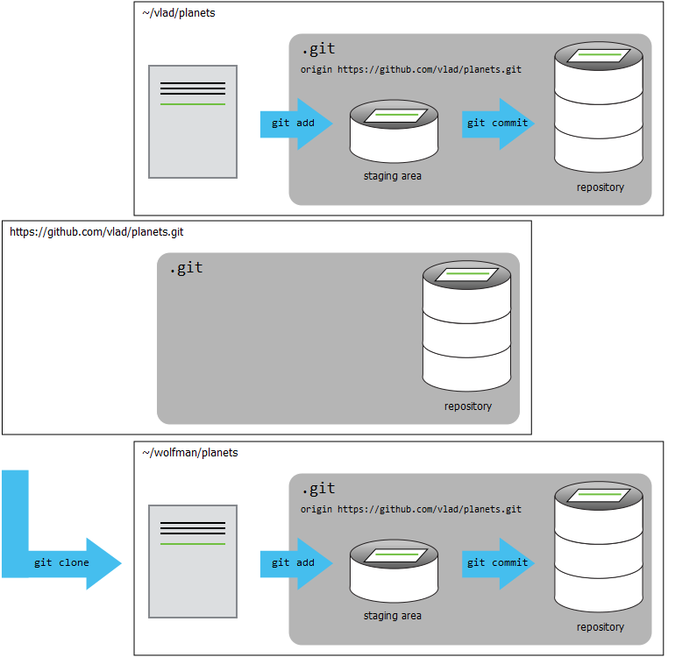

Slide 29
Conflicts
Questions
What do I do when my changes conflict with someone else’s?
Objectives
Explain what conflicts are and when they can occur.
Resolve conflicts resulting from a merge.

Slide 30
